Slide 1
i4Trust – Multi-tier support
Juanjo Hierro - CTO FIWARE Foundation

Slide 2


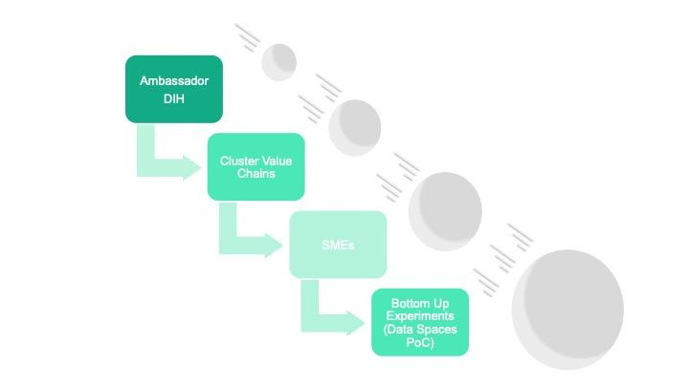

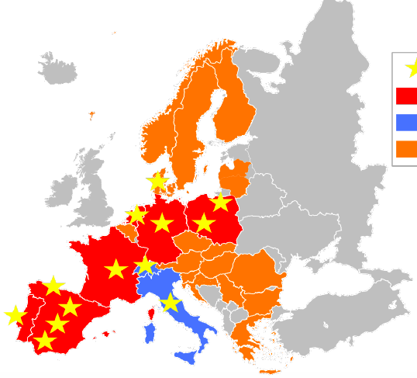

Going beyond the technology: a vibrant Community
Training Technical Support
<
32 BuE – 150+ SMEs
(Bottom-up Experiments
Digital Innovation Hubs (DIHs)
Future experiments
Market solutions
Community
Community Platform Community Mgmt
<

Slide 3
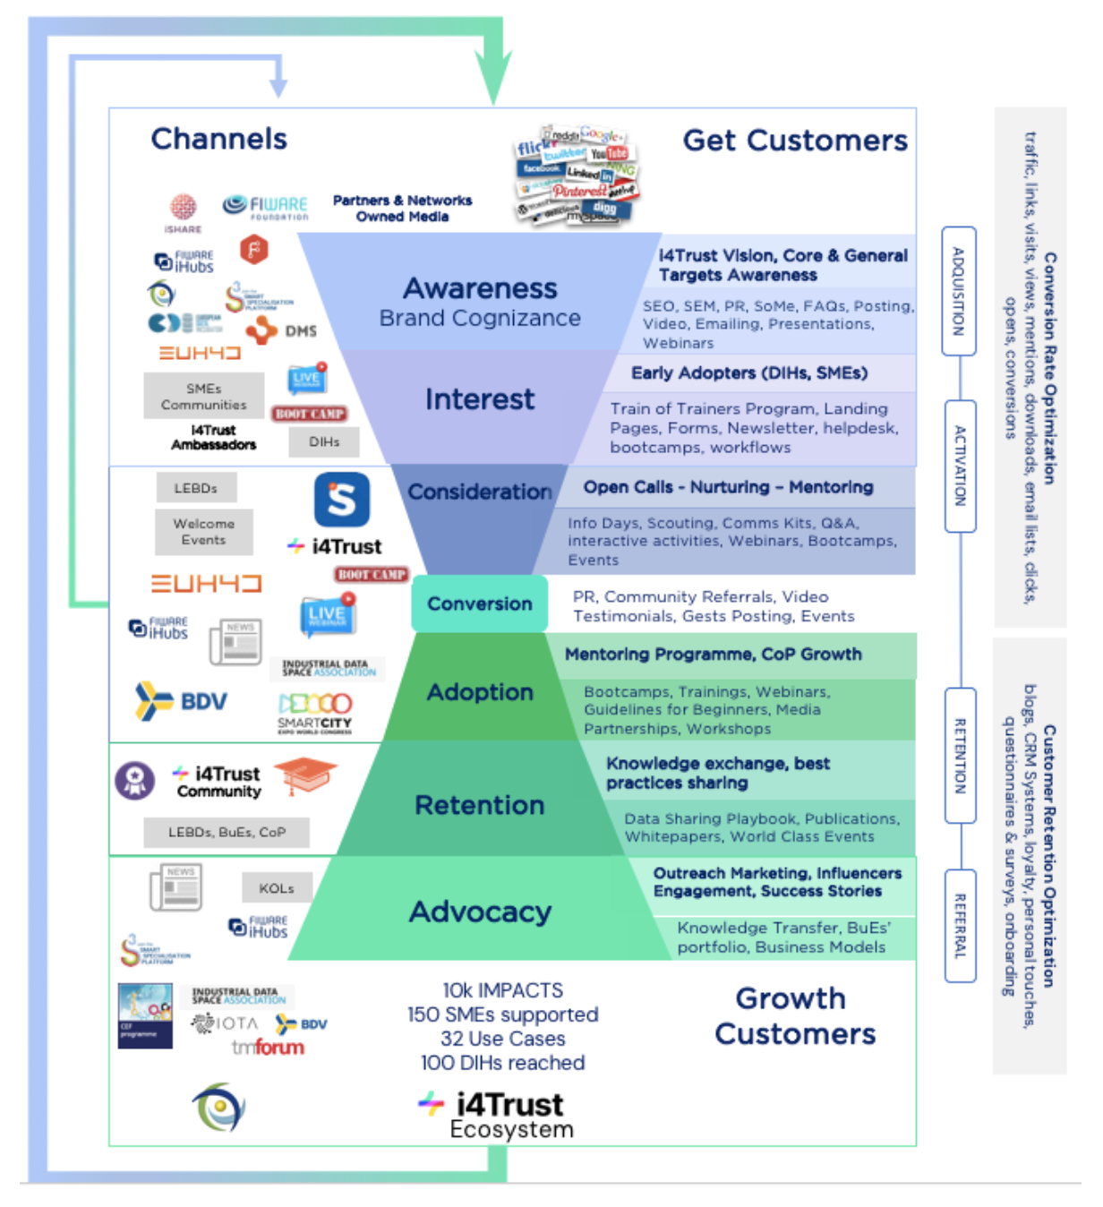

Towards a sustainable i4Trust Community
Adequate support is essential to create trust on our Community
Technical support, e.g.:
How can my organization join an i4Trust Data Space as participant?
How can our organizations setup services supporting a i4Trust Data Space?
Non-technical support, e.g.:
How can my organization create new value out of sharing data?
How can governance of an i4Trust Data Space be defined?
Such support should cover target audiences:
Organizations willing to operate/govern i4Trust Data Spaces
Organizations willing to participate in i4Trust Data Spaces
DIHs that may join the Community
DIHs are called to play a essential role in providing the necessary support to grow the i4Trust Community and i4Trust adoption:
iSHARE and FIWARE Foundations alone not enough to handle scale
It shouldn’t be seen by DIHs as a problem/burden: it is an opportunity

Slide 4



Multi-tier support overview
Tier 0 – Self-help by own users
Tier 1 - Basic helpdesk resolution
Tier 2 - In-depth business or technical support
Tier 3 - Expert service support
Tier 0
i4Trust users
Helpdesk Agents
Tier 1
DIHs
LEBDs & Ambassadors
Tier 2
DIHs
i4Trust Experts
Tier 3
Notes:
Resolution of questions within the i4Trust Community will be handled following a multi-tier support where DIHs will primarily play the role of Tier 1 and Tier 2:
Tier 0 - Self-help and user-retrieved information. Users (SMEs) retrieve support information from i4Trust Community Portal and use the official helpdesk channel to send questions and requests to upper support tiers.
Tier 1 - Basic helpdesk resolution and service desk delivery. Lower-level technical questions as well as non-technical questions will be solved by personnel from DIHs that have joined the i4Trust Community, trained to solve known questions whose answers have been documented, will attend the users requests. Personnel at this level are also responsible for gathering, according to defined scripts, all the info required for subsequent tiers. Support in this Tier is collaborative, so requests that arrive through the help-desk space can be self-assigned by any of the organizations that have joined this Support Tier and we allow that a given request is self-assigned (therefore answered) by several organizations. When a SME issues a request and it doesn’t get satisfied with the answer they will be able to signal it (so that experts from i4Trust core partners can answer). If a request does not get self-assigned until a certain time, experts from i4Trust core partners will self-assign it.
Tier 2 - In-depth business or technical support. Ambassadors appointed for the corresponding DIH will attend locally the business requests which cannot be handled by Tier 1. LEBDs appointed for the corresponding DIH, trained with a deep knowledge of the B2B Data Sharing Enablers readiness, will attend locally the technical issues which cannot be handled by Tier 1. When a SME issues a request and it doesn’t get satisfied with the answer they should be able to signal it (so that experts from i4Trust core partners can answer).
Tier 3 - Expert service support: specialists provided by i4Trust core partners will solve requests which couldn’t be handled in previous Tiers.

Slide 5

Tier 0 – Self-help
Users (SMEs or DIHs) can directly retrieve support information from i4Trust Community websites or other technical sources:
i4Trust.org:
Technology - Training
FAQ
Resources
…
Previous Q&A’s formulated on i4Trust Helpdesk space (via JIRA?)
Previous Q&A’s about FIWARE components on StackOverflow
In the event they don’t find answer to their questions, they formulate them in the official i4Trust Helpdesk space
Whenever a question is formulated, a JIRA ticket will be created to keep track how that question is handled by Tiers 1-3
Hint: wait until JIRA ticket is created and a first reply is published to a formulated question where link the JIRA ticket is included

Slide 6
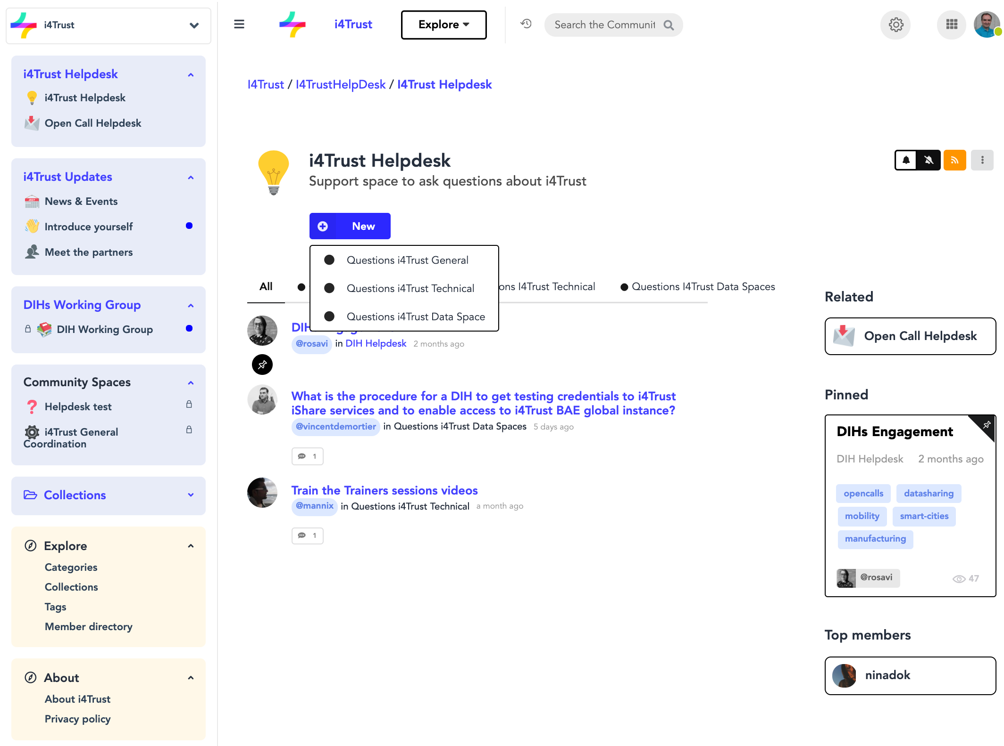
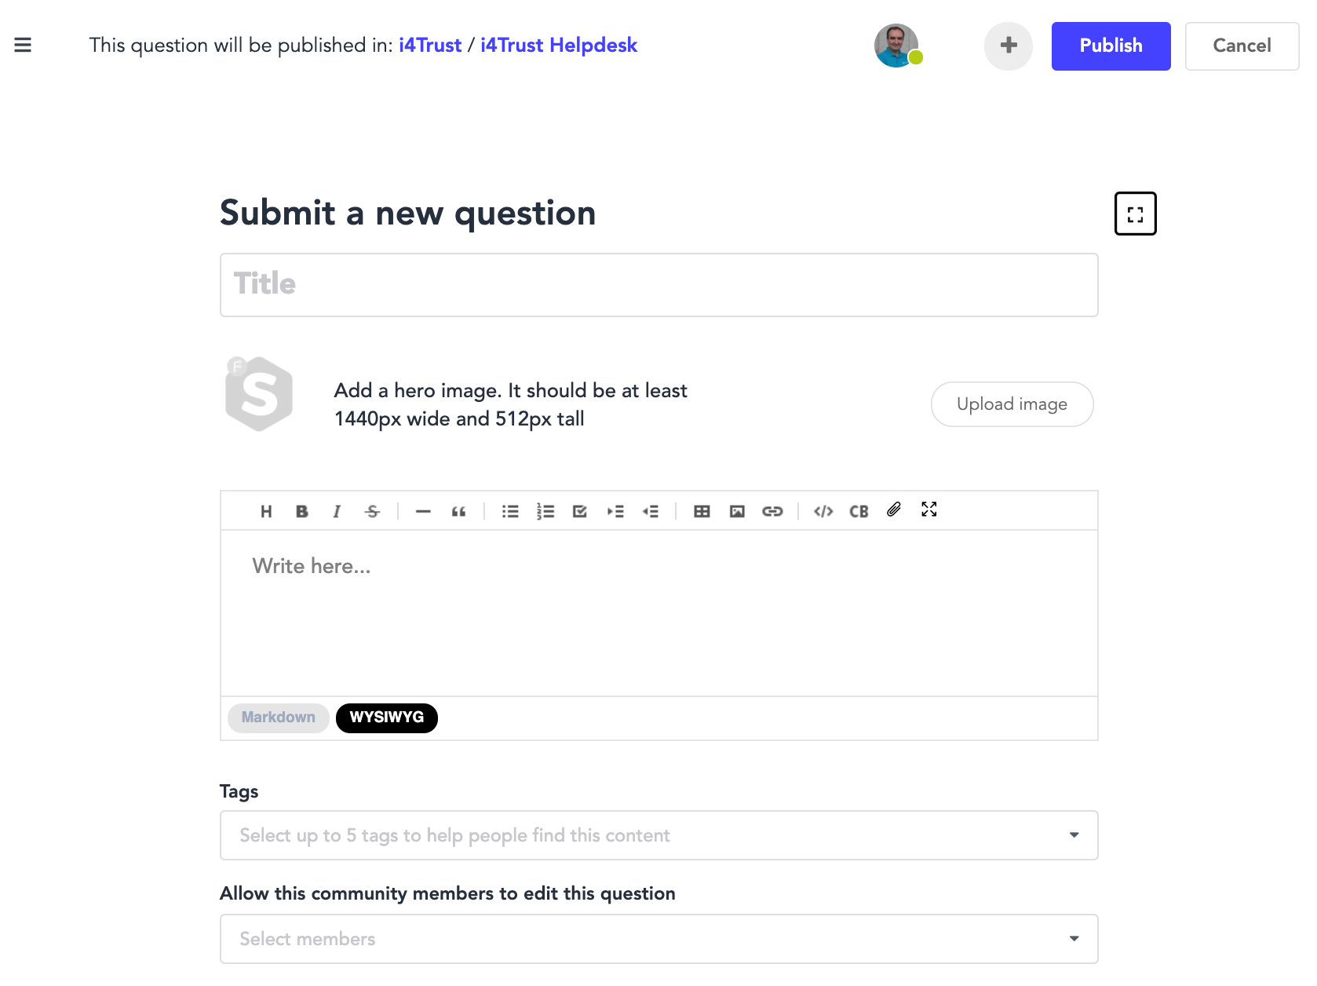
i4Trust Helpdesk space

Slide 7
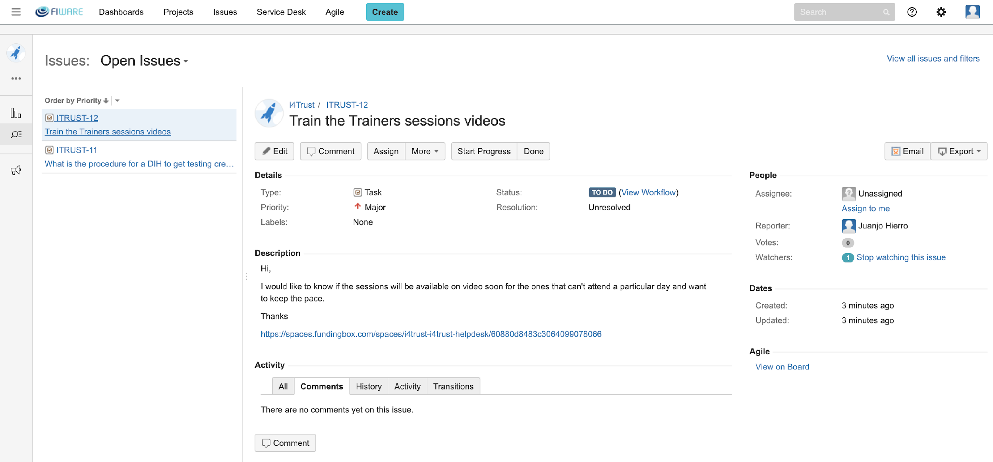
Managing support via trouble-ticketing system (JIRA)
Ability to create tickets
List of open issues
Questions issued on the i4Trust Helpdesk space have an URL to be added to the description of the ticket on JIRA

Slide 8
Managing support via trouble-ticketing system (JIRA)
Assignment of tickets
Execution of actions on workflow
Priority assigned to the JIRA ticket
Ability to add comments (recommended for each transition)
JIRA user the ticket has been assigned to

Slide 9
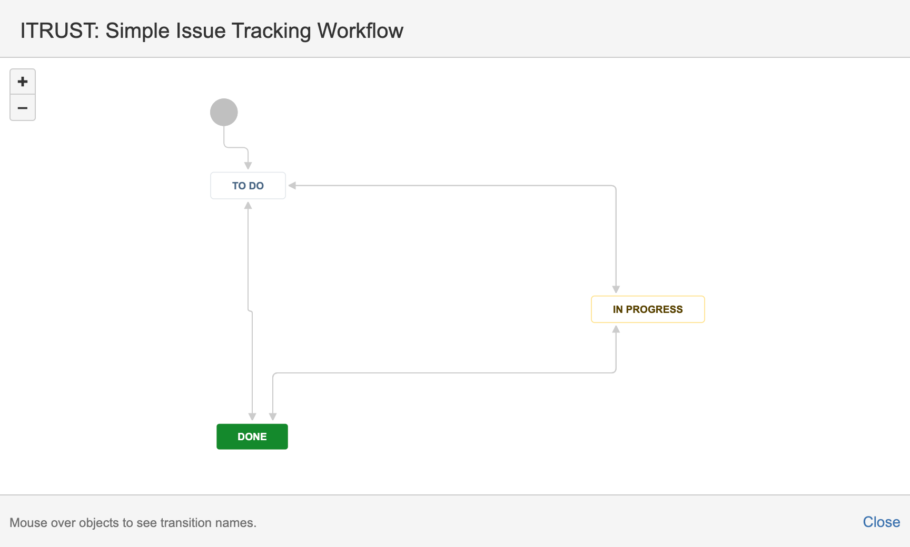
Basic JIRA ticket workflow

Slide 10
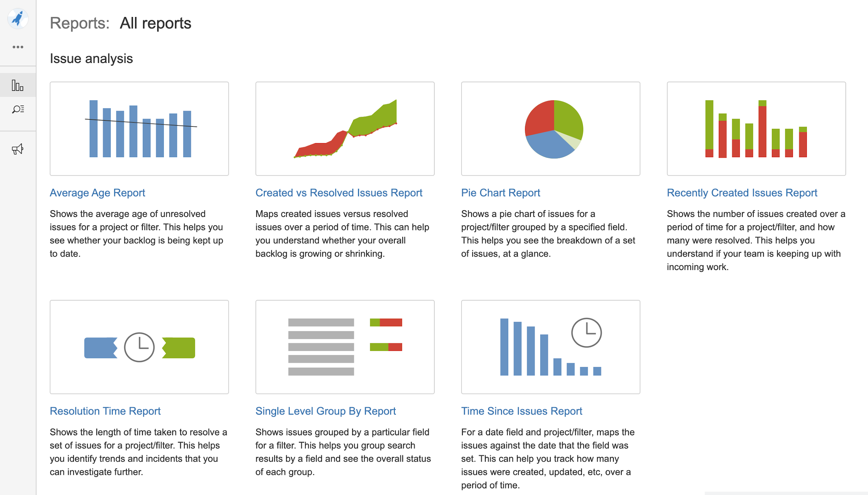
Goal: being able to monitor and report on handling of tickets

Slide 11

Notes regarding JIRA
DIHs will be assigned a user account in the ITRUST JIRA project that has been created:
<DIH-id>.Helpdesk (Tier1)
<DIH-id>.LEBD
<DIH-id>.Ambassador
A JIRA ticket will be created whenever a request is formulated on the i4Trust Helpdesk space and the ticket id (ITRUST-<number>) will be reported to the user as a first answer:
Initially, i4Trust core partners will take care of creating the JIRA ticket manually
However, soon JIRA tickets will be created automatically
The DIH that decides to handle a request should first self-assign the corresponding ticket on JIRA

Slide 12
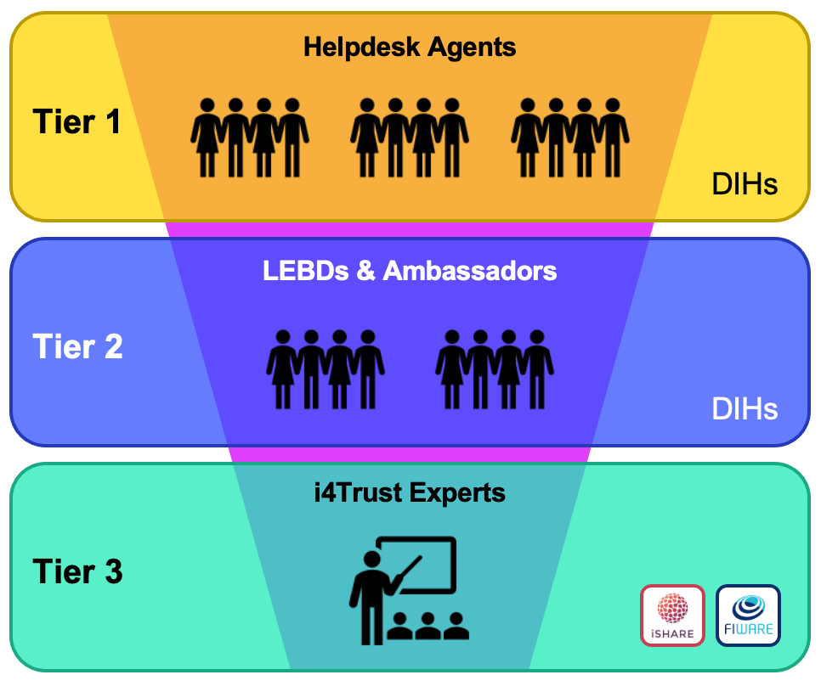
Tier 1 – Basic help resolution
Support is collaborative, so requests that arrive through the help-desk space can be self-assigned by any of the DIHs in the Community:
DIHs have the opportunity to connect with the given organization
Note that several organizations may be able to answer a given question
DIHs may allocate people at this Tier managing the requests according to defined support scripts (e.g., check whether answer to the question is part of a published FAQ) and forwarding the request to the next tier if they don’t find a standard answer
If a given request does not get self-assigned until a certain time, experts from i4Trust core partners will self-assign it
When a SME issues a request and it doesn’t get satisfied with the answer they will be able to signal it (so that experts from i4Trust core partners can answer)

Slide 13
Tier 2 – In-depth technical or business support
DIHs should allocate people at Tier 2 able to handle requests assigned to them (forwarded) by people at Tier 1
Ambassadors will attend business-oriented requests
LEBDs will attend the technical-oriented requests
People at Tier 2 are also able to directly self-assign a request from a given user
If they feel like they don’t know how to handle a request, they can assign the request (JIRA ticket) to i4Trust core partners for solving it by means of assigning it to a designated JIRA user
When a SME issues a request and it doesn’t get satisfied with the answer they should be able to signal it (so that experts from i4Trust core partners can answer)

Slide 14
Tier 3 – Experts Service Support (i4Trust core partners)
i4Trust core partners will allocate people at Tier 3 able to handle requests assigned to them (forwarded) by people at Tier 1
People at Tier 3 are also able to directly self-assign a request from a given user
Questions in connection to FIWARE components may be handled via existing FIWARE support channels:
Users may be requested to formulate their questions on StackOverflow where a curated body of knowledge is being generated for FIWARE components
Some tickets may be forwarded to the FIWARE Tech Helpdesk

Slide 15
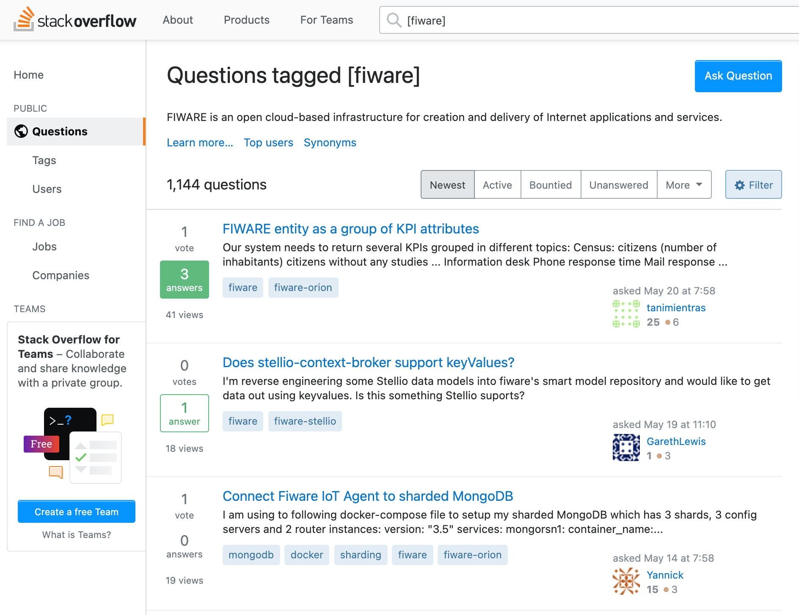
StackOverflow
StackOverflow is reserved for rather curated questions
If you have doubts, don’t hesitate to forward the request to Tier 3 and we will decide whether the question is suitable for that forum

Slide 16


Summary
Support tasks bring a great opportunity to connect to potential i4Trust users and engage with them
It is a collaborative effort:
don’t ask only what the i4Trust Community can do for you but also what you can do for the i4Trust Community
i4Trust core partners will always be there for help!
Connection of the i4Trust Helpdesk space with JIRA will ensure proper management following a multi-tier approach
A constant monitoring on progress handling JIRA tickets will pave the way for success in giving support to our users!

Slide 17
Follow @i4Trust on Twitter
Visit https://i4Trust.org
Contact of coordinator: juanjose.Hierro@fiware.org

